Slide 1
Look Away Game!
Super Look group

Slide 2
What is look away?
A simple game
Do not look in the same direction as the arrow
Look in same direction and lose a life

Slide 3
Game Mechanics
Generates arrow in cardinal direction
Enter input within time constraint
ie) If ‘^” is displayed then <,>,v would be correct

Slide 4
Features
Difficulty : Easy, Medium, Hard
Lives: Input incorrect enough times and the game ends
Score: Keeps note of how many correct
Time Management: Manage timing of user input
Color Arrow: Helps users know that a new round occurred
Error Handling: Address user mistakes
Screen Clear Functionality: Cleared screen between game iterations
Exceutable File Creation: cpp into .exe

Slide 5
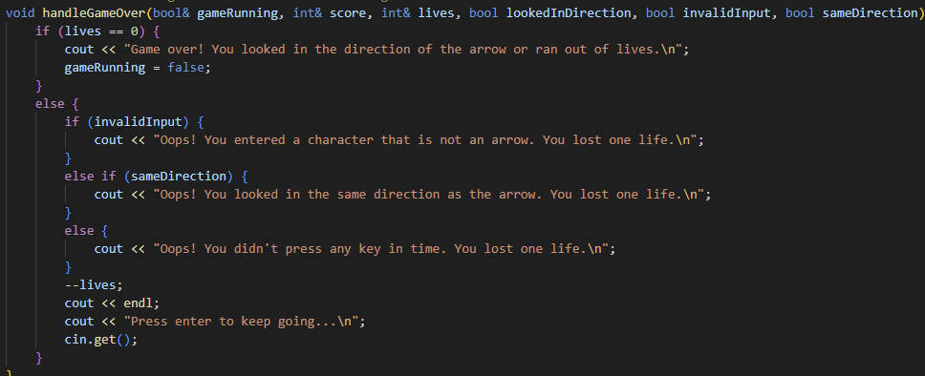
Highlights 1/4
Handles any action that interacts with the lives variable so there are reactions for all cases of whatever the user inputs.

Slide 6
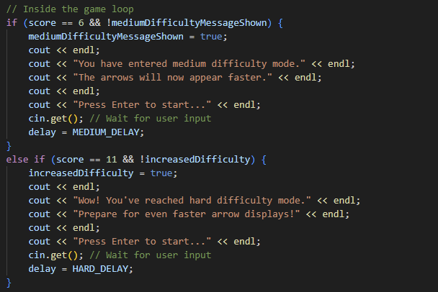
Highlights 2/4
How game gets difficult over time.
There are three difficulty levels.
The difficulty level changes after 5 correct arrows.
The medium difficulty shown flags it tells program that the message for medium difficulty has been shown. Same is true for increase difficulty.

Slide 7
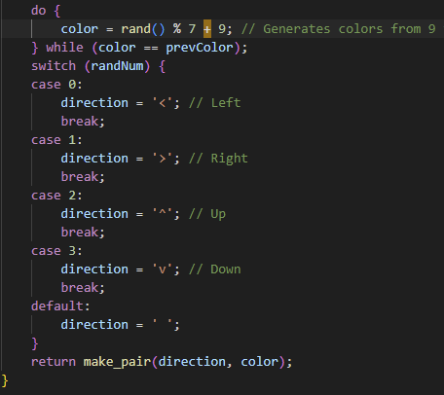
Highlights 3/4
Display direction <,>,^,v with color to help the user know a new round has started.
It is a pair since it needs to return two values.

Slide 8
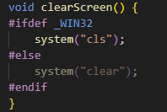
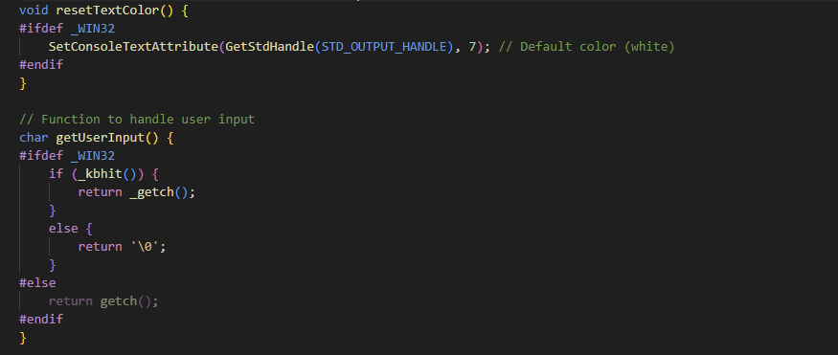
Highlights 4/4
Since the game is in an .exe file, it was mainly tested in a Windows environment. Mainly, the Windows terminal as that was easiest way to make the code work

Slide 9
Conclusion
The "Look Away Game," game was conceived with the goal of collaboratively coding in C++. It was designed to run off of a windows console, instead of a graphical user interface(GUI). Our collective efforts resulted in the creation of a code that effectively simulates a simple yet robust (bussin -niori ;0) gaming experience.

